Slide 1
Introduction to the Theory of Computation
Fall Semester, 2015-2016
School of Information,
Renmin University of China

Slide 2
Contact Information
Instructor: Dr. Chunlai Zhou(周春来)
Email: czhou@ruc.edu.cn
Office: 303A, Wing Building of Science Complex, Tel: 62510042
Office hours: 2-5pm Feb.
Meeting Time: 6-8:30am Feb.

Slide 3
Textbook
Michael Sipser: Introduction to the Theory of Computation, second edition, 2006
J. Hopcroft, R. Motwani and J. Ullman, Introduction to Automata, Languages, and Computation, Third edition, China Machine Press, 2007 (database)
Supplementary Readings:
C. Baier and J. Katoen, Principles of Model Checking, 2008, MIT Press. (software engineering)

Slide 4
Grading
Biweekly Homework (totally 6, 20%)
Take-home Midterm (20%)
Final Exam (60%)
Suggestions:
Preparation: Spend 30 minutes quickly looking at what will be taught before class
Review: Spend 2 hours reading carefully the materials in Textbook after class

Slide 5
Outline of the Course
Automata Theory (5 weeks)
With its application on Model Checking
Computability Theory (3 weeks)
Mid-term is in the 9th week
Complexity Theory (8 weeks)
Prerequisites:
Discrete Mathematics and
basic knowledge of algorithms

Slide 6
If you have taken this course before,
you can expect the following new materials:
Application to Model Checking
Connections to foundations of Mathematics
Relations to Cryptography

Slide 7
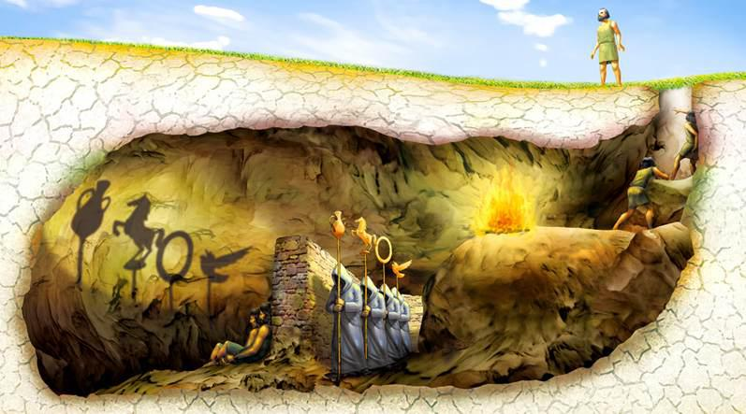
Why Theory? Metaphor of Plato’s cave
Platonism refers to the philosophy that affirms the existence of abstract objects, which are asserted to "exist" in a "third realm" distinct both from the sensible external world and from the internal world of consciousness

Slide 8
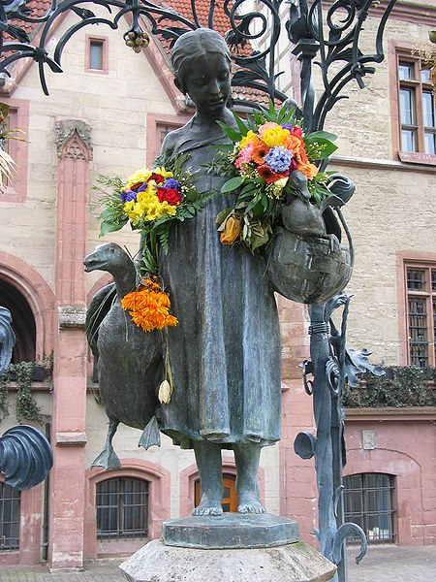
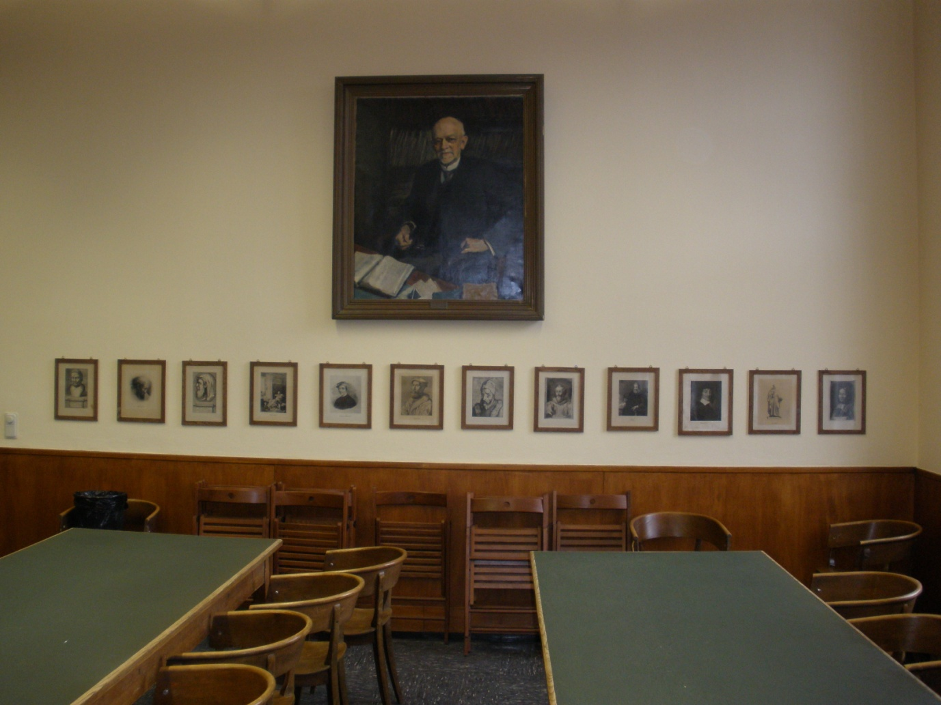
Where our journey starts: Goettingen and HER Mathematics
Ganseliesel:
the landmark of Goettingen
David Hilbert and
Men of Mathematics

Slide 9
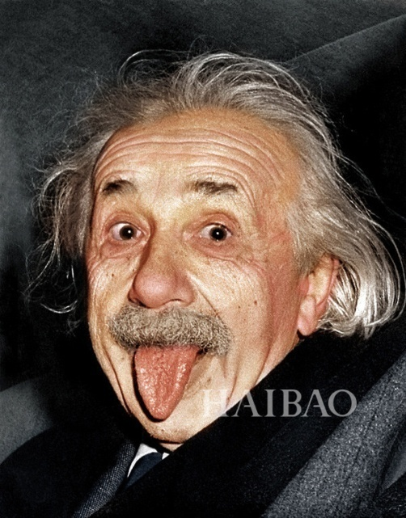
Axiomatic systems
“Development of Western science is based on two great achievements:
the invention of the formal logical system(in the Euclidean geometry)
by the Greek philosophers, and the discovery of the possibility to find
Out the causal relationships by systematic experiments”

Slide 10
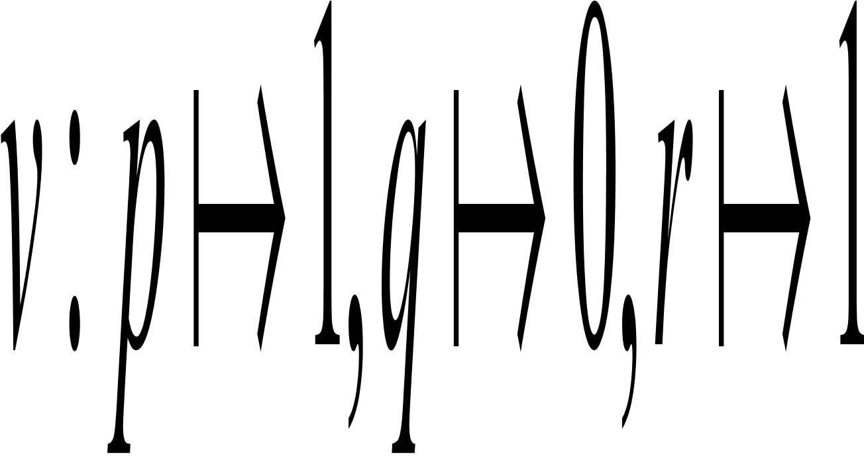
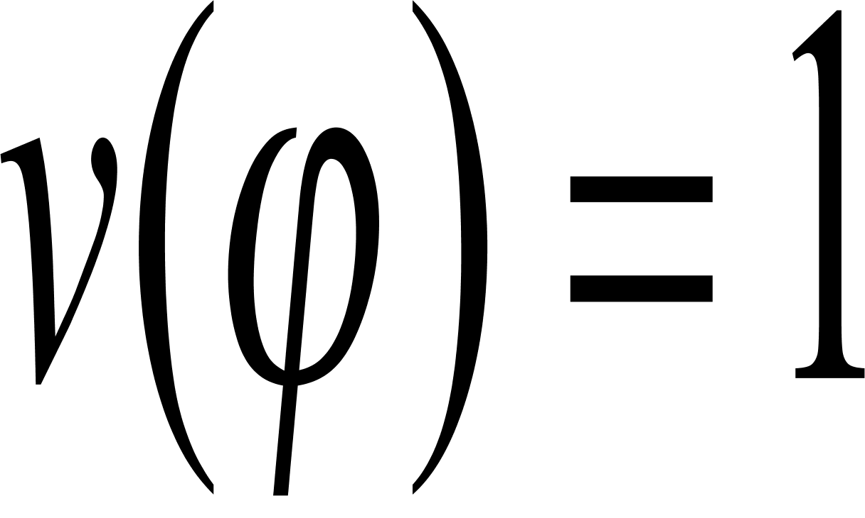
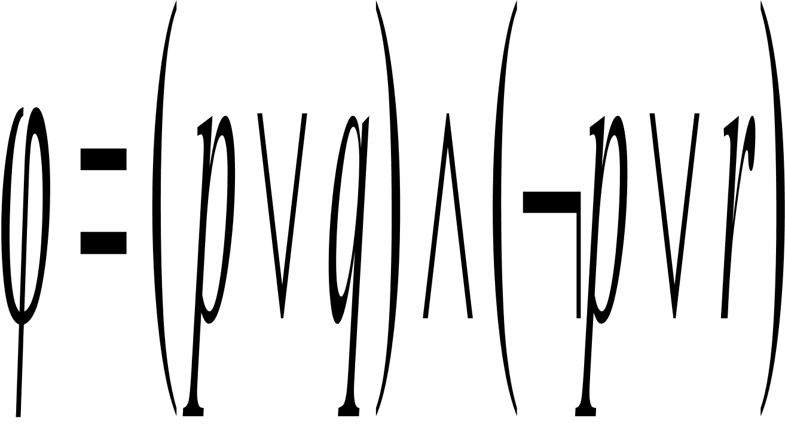
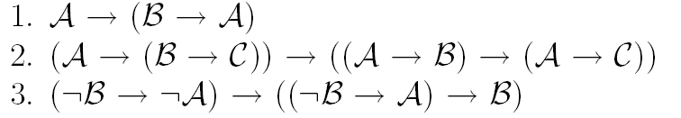
Soundness and Completeness Truth vs Consistency, Valid vs Provable
Semantics
valuation
Syntax

Slide 11
A Brief History: Hilbert’s Program
Hilbert’s program (from wikipedia)
Axiomatization of all mathematics
Completeness: all true mathematical statements can be proved in the formalism
Consistency: no contradiction can be obtained in the formalism of mathematics
Decidability: there should be an algorithm for deciding the truth or falsity of any mathematical statement
“We must know. We will know”.

Slide 12
History: Godel’s Incomplete Theorems
Godel’s first incompleteness Theorem
no consistent system of axioms whose theorems can be listed by an "effective procedure" (essentially, a computer program) is capable of proving all facts about the natural numbers.
However, in 1940’s Tarski showed that the first order theory of the real numbers with addition and multiplication is decidable. In this sense, number theory is more difficult than real analysis to computer scientists.

Slide 13
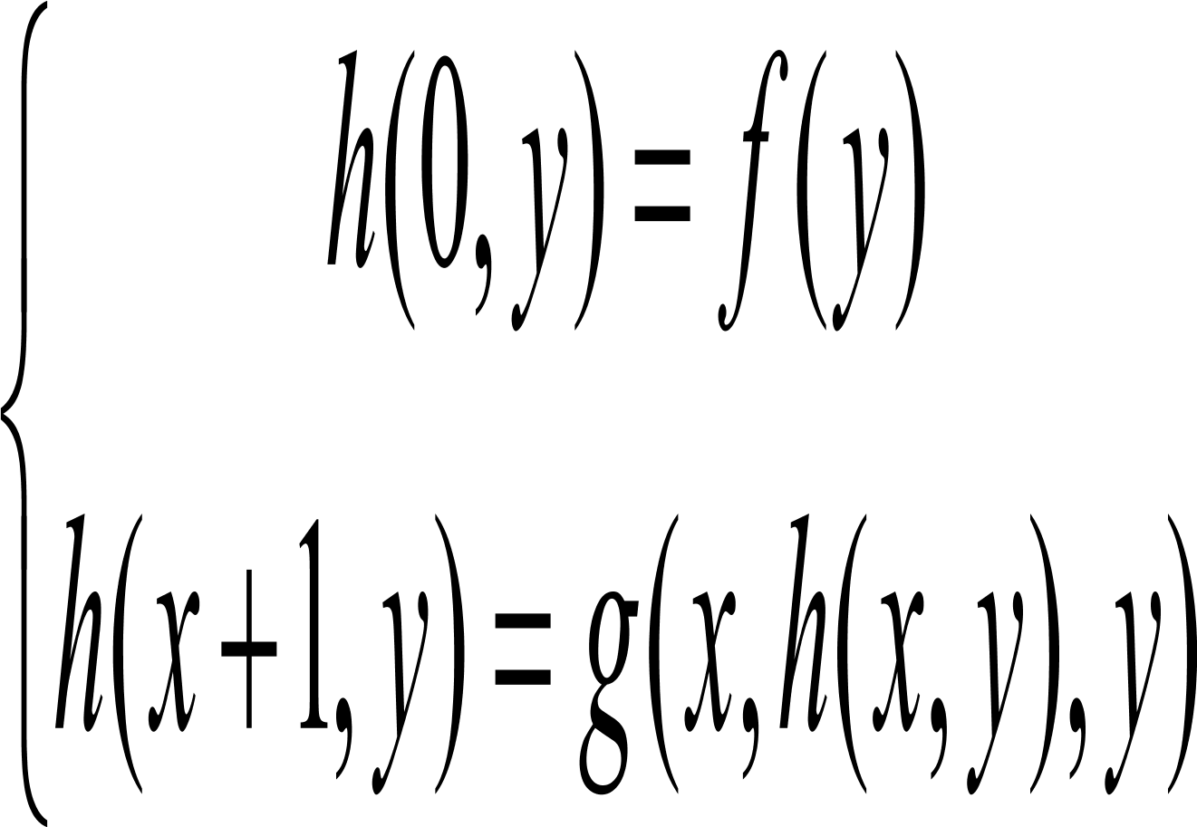
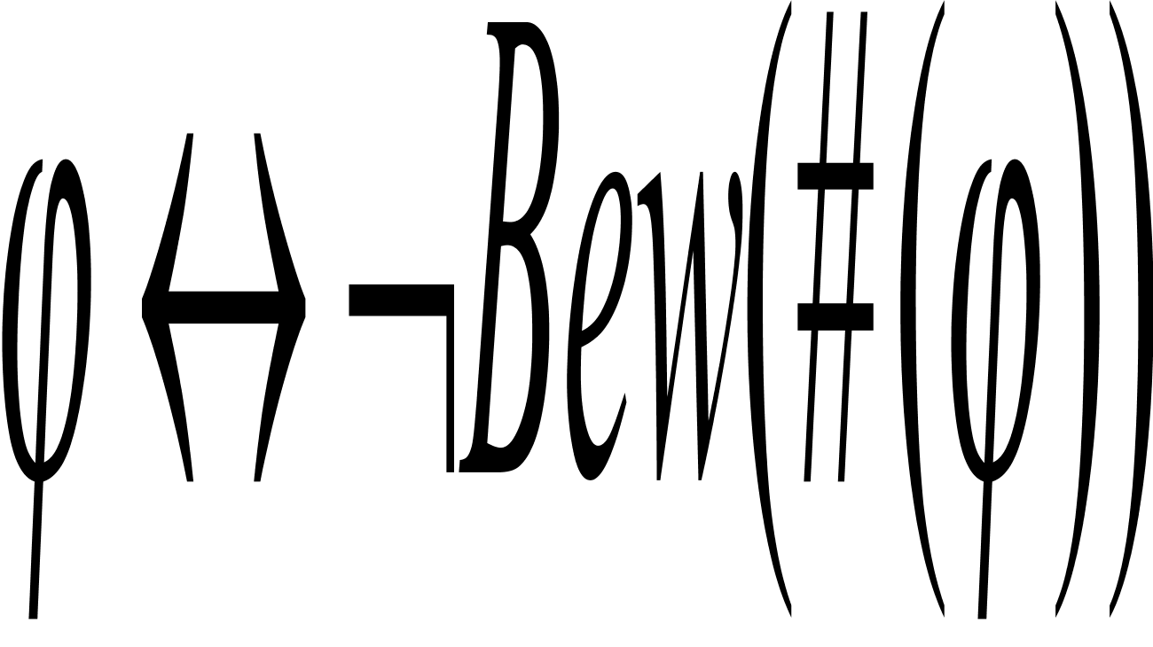
Goedel’s proof
Goedel numbering (artithemetization of syntax)
Primitive recursion
Self-reference: Liar Paradox
Bew(y) = ∃ x ( y is the Gödel number of a formula and x is the
Gödel number of a proof of the formula encoded by y)

Slide 14


Goedel and Turing (1931-1936)
(1912-1954)
Last year is the Turing year!
Goedel (1906-1978)

Slide 15
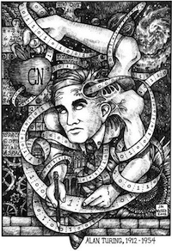
History: Turing Machine (1936)
State
A
Action: based on
the state and the
tape symbol under
the head: change
state, rewrite the
symbol and move the
head one square.
A
B
C
D
Infinite tape with
squares containing
tape symbols chosen
from a finite alphabet
. . .
. . .

Slide 16
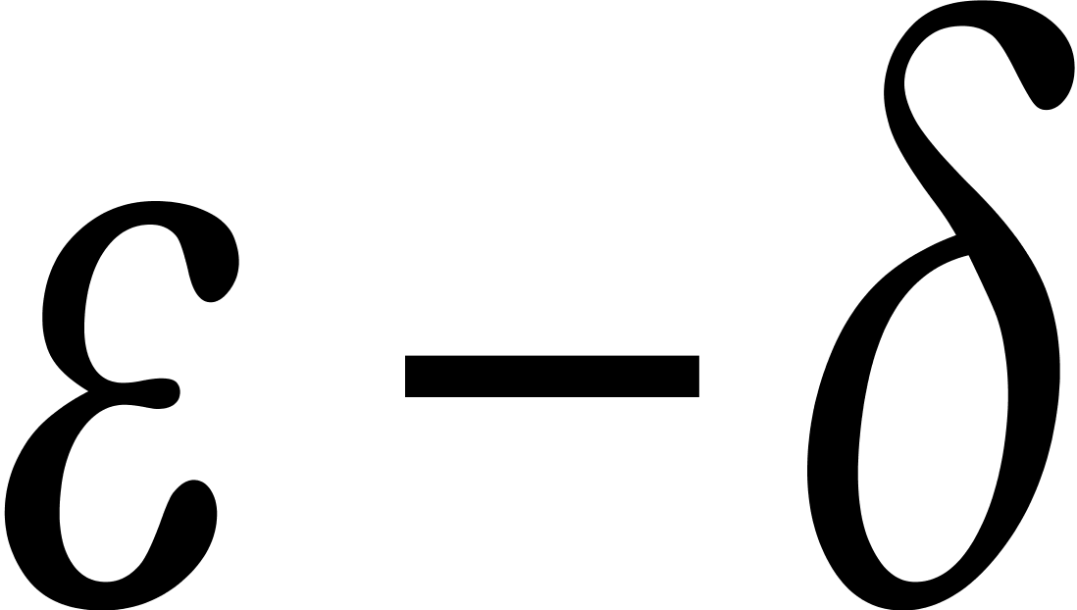
Church-Turing thesis
Intuitive notion
of algorithm
Turing machine
algorithm
=
f=2x+1 is continuous
=
Prove by definition
An algorithm is a finite collection of instructions for
carrying out some task.

Slide 17
Universal Turing machine
program
<M>
string w
w
input
A particular
purpose TM
Universal TM
output
output
U can simulate any TM.
.

Slide 18
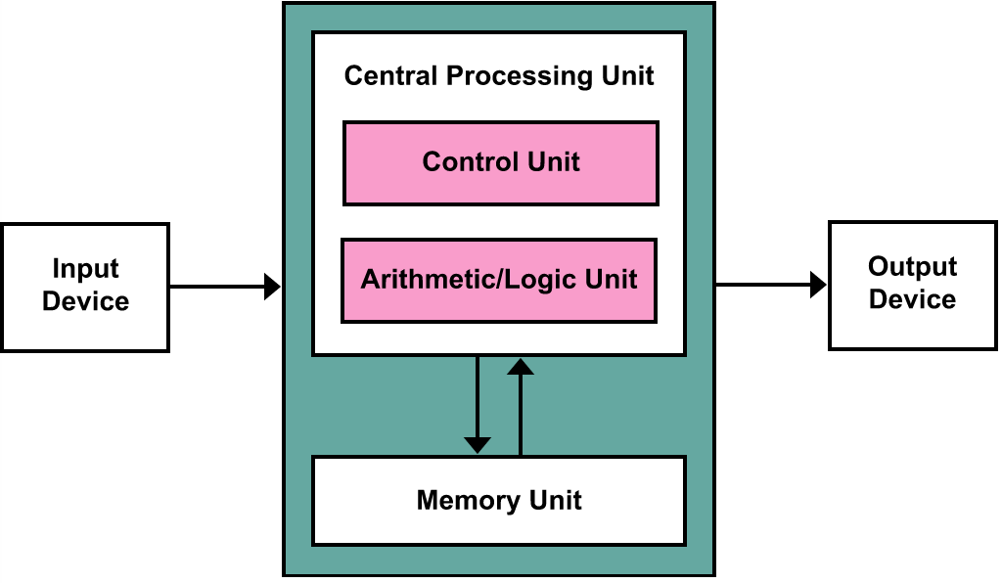
von Neumann architecture
把程序本身当作数据来对待，程序和该程序处理的数据用同样的方式储存。
冯·诺依曼和同事们依据此原理设计出了一个完整的现代计算机雏形，
并确定了存储程序计算机的五大组成部分和基本工作方法。冯·诺依曼的这一设计思想
被誉为计算机发展史上的里程碑，标志着计算机时代的真正开始。

Slide 19
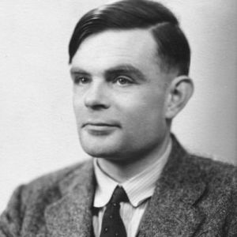
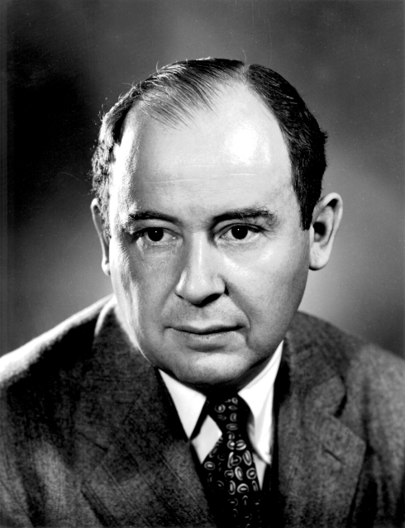
Turing met von Neumann
ACM Turing Award
IEEE von Neumann Prize

Slide 20
Other Models of Computation
Lambda Calculus (Church)
Programming languages
Recursion Theory (Kleene, Rosser)
Computable Mathematics
Combinatory Logic (Curry)
Type Theory in Programming Languages

Slide 21
History: Automata
Scott & Rabin: Finite Automata and their Decision Problems, 1959
Kleene: Regular languages
In a nonderministic machine, several choices may exist for the next state at any point.

Slide 22
A Simple Automata
Automatic Door as an automaton
Front
Rear
Both
Rear
Both
Neither
Front
closed
closed
closed
closed
closed
Open
closed
closed
Neither
Neither Front Rear Both
Closed
open
Closed Open Closed Closed
Open Closed Open Open

Slide 23
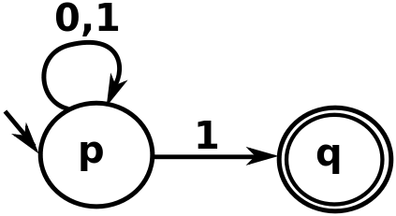
Non-deterministic Automata

Slide 24
Automata = Regular expressions
Scott & Rabin
DFA
NFA
=
||
||
Regular
Expressions
GNFA
=
Kleene

Slide 25
Why Study Automata Theory
Software for designing and checking the behavior of digit circuits
Software for verifying systems of all types that have a finite number of distinct states, such as communication protocols or protocols for secure exchange of information.

Slide 26
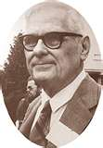
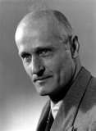
Church and Kleene
(1903-1995)
(1909-1994)

Slide 27
Why Study Computability Theory (1)
Halting Problem:
Given a description of a program, decide whether the program finishes running or will continue to run, and thereby run forever. This is equivalent to the problem of deciding, given a program and an input, whether the program will eventually halt when run with that input, or will run forever.

Slide 28
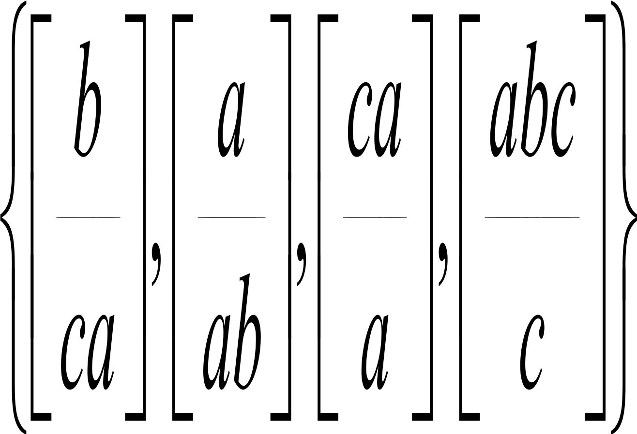
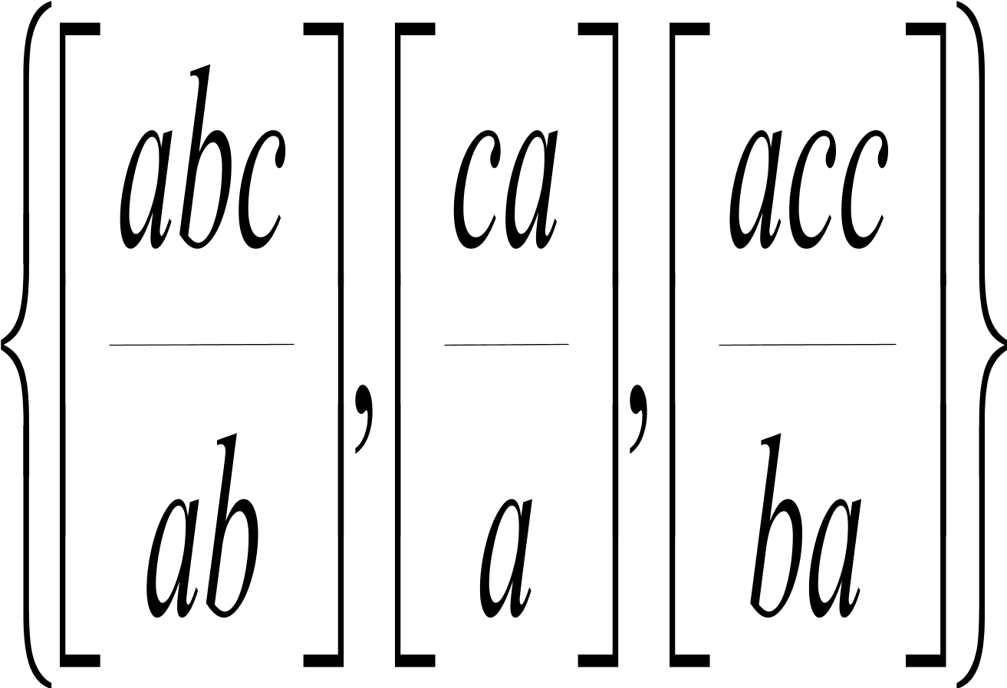
Why Study Computability Theory (2)
Post Correspondence Problem
The Post correspondence problem is unsolvable by algorithms.

Slide 29
History: P and NP
Cook-Levin Theorem: SAT is NP-complete.
Classify into two kinds of problems:
Those that can be solved efficiently by computers
Those that can be solved in principles, but in practice take so much time that computers are useless for all but very small instances of the problem.

Slide 30
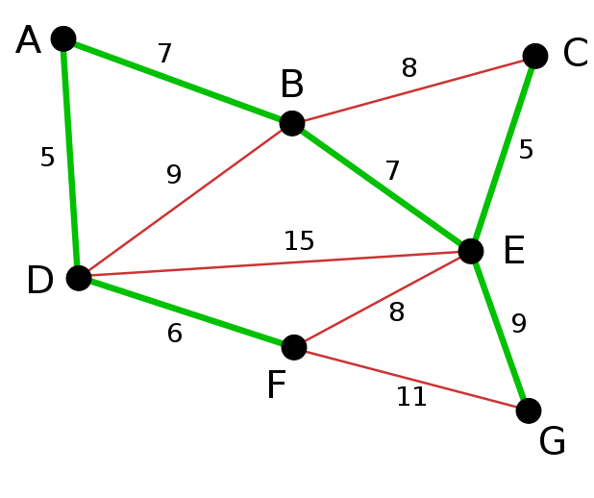
Why Study Complexity Theory (P)
Kruskal Algorithm (Minimal spanning tree problem)

Slide 31
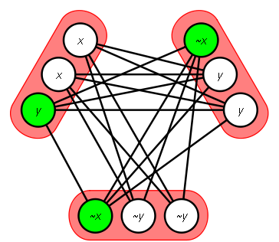
Why Study Complexity Theory (NP)
Clique Problem

Slide 32
Why Study Complexity Theory (Application)
Primality Testing and Cryptography
There are a number of techniques based on RSA codes that enhance computer security, for which the most common methods in use today rely on the assumption that it is hard to factor numbers, that is, given a composite number, to find its prime factors.
Shor’s algorithm and Quantum Computation

Slide 33
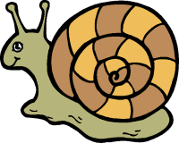

Classical Theory
Algorithm (Computability)
Decidability
Efficiency (P vs. NP)
decidable
inefficient
efficient

Slide 34
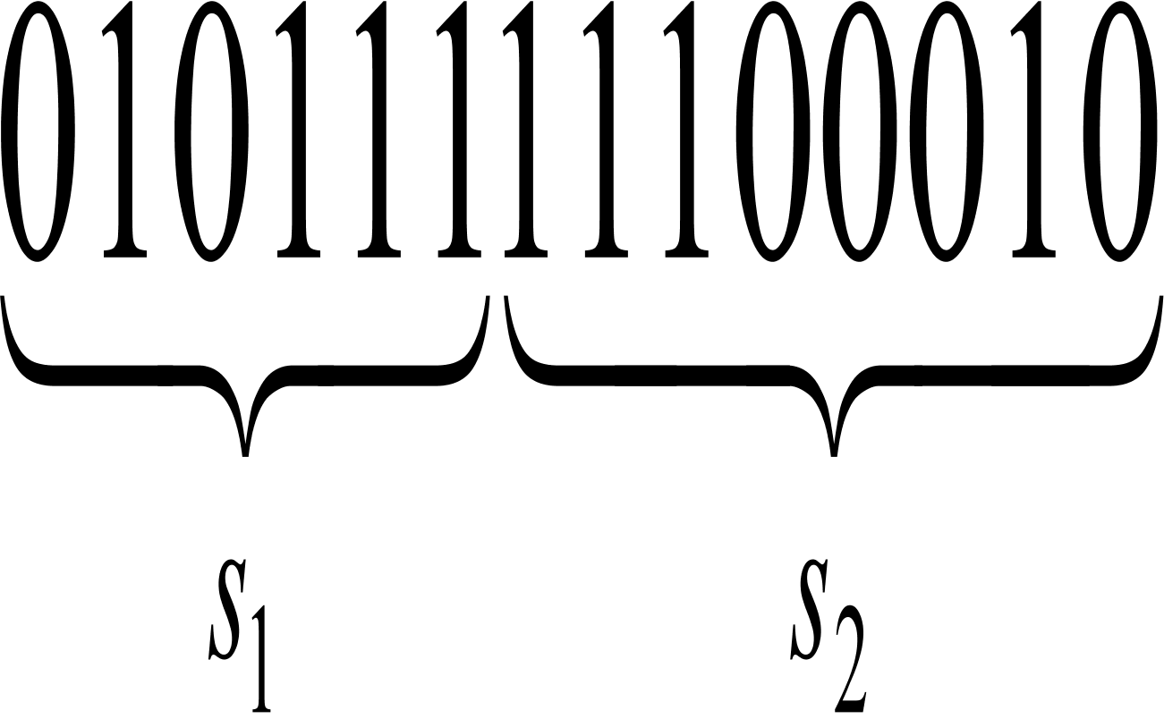
Strings and Languages
Alphabet: a finite set of symbols,
A string over an alphabet is a finite sequence of symbols from the alphabet
Concatenation: Operations on strings
A language is a set of strings.

Slide 35
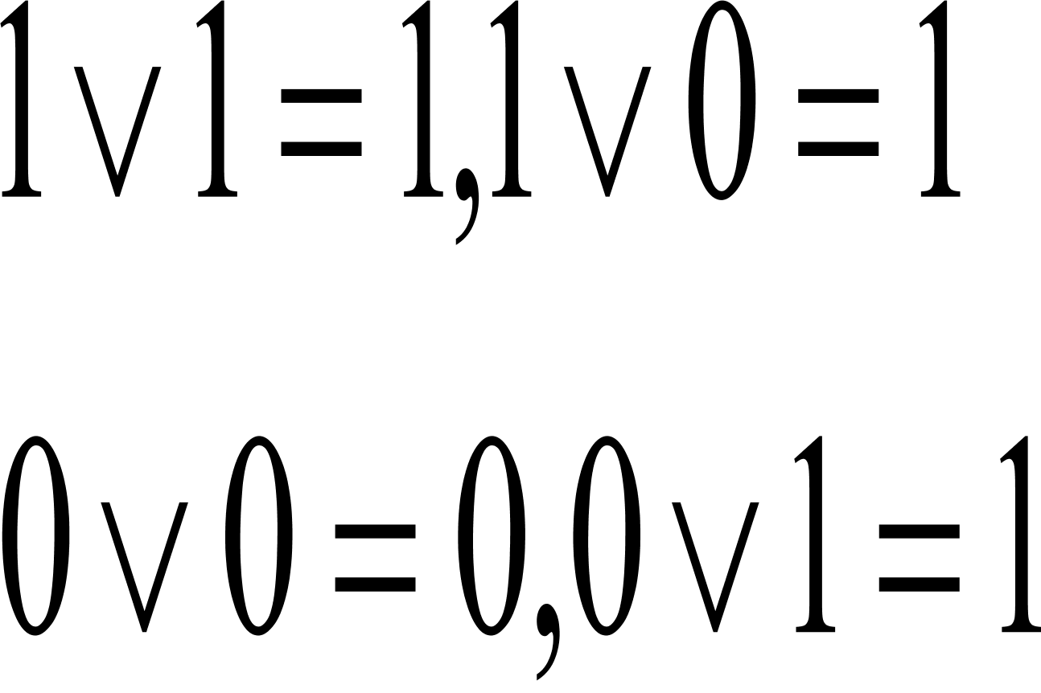
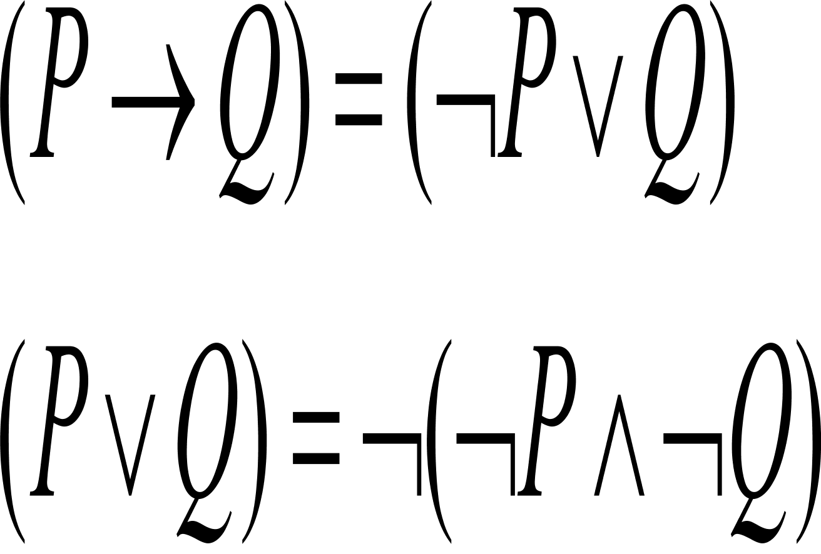
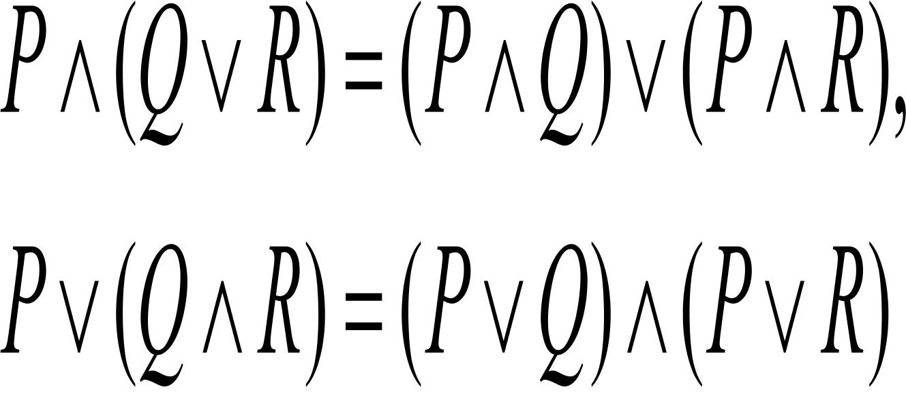
Boolean Logic
Boolean operations: negation, conjunction (AND), disjunction (OR)
Equivalent expressions
The distributive laws

Slide 36
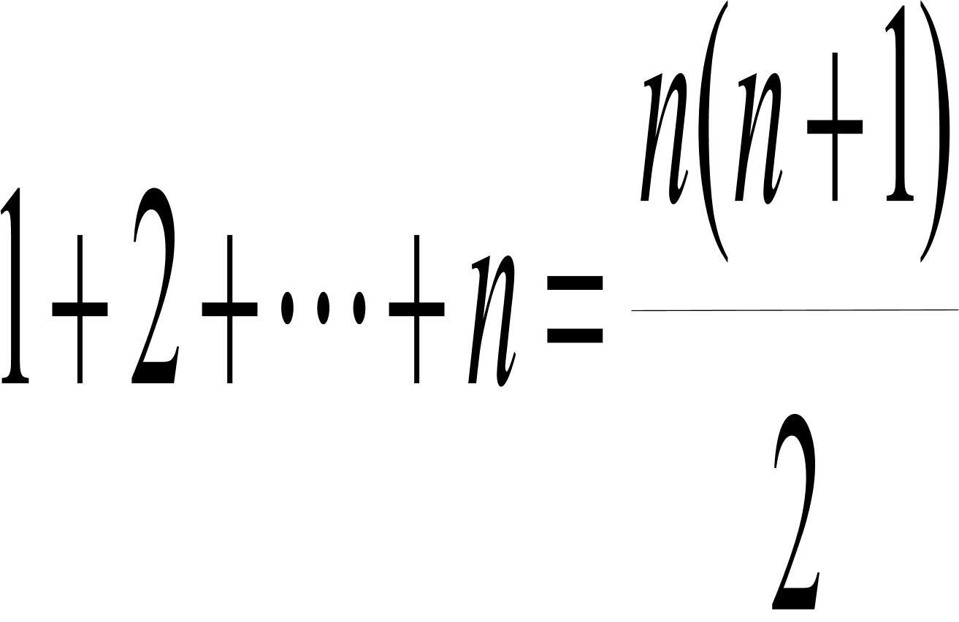
Proofs
Usually a mathematical argument consists of definitions, axioms, lemmas, theorems and corollaries
Types of proofs
Proof by construction
Chinese Remainder Theorem
Proof by contradiction
There exist infinitely many prime numbers.
Proof by induction
Integer Induction

Slide 37
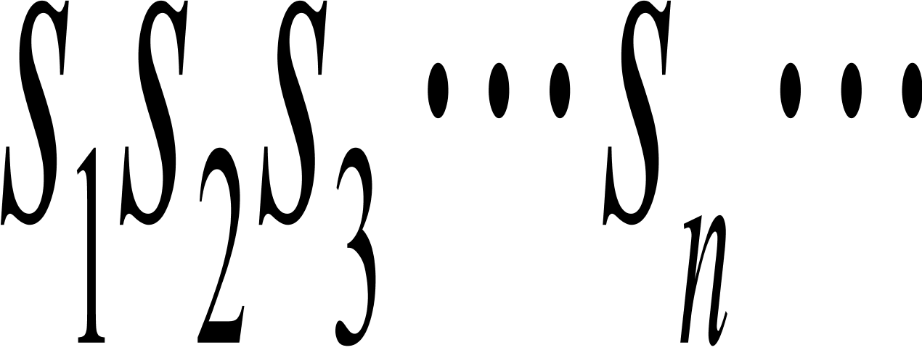
Deductive Proofs
A deductive proof is a finite sequence of statements
satisfying the following condition:
each statement is either
a hypothesis or
deducible from several previous statements according to one rule in a finite rule set.

Slide 38
Structural Induction
Definition: An expression is defined inductively as follows:
Any number or letter is an expression
If E and F are expressions, so are E+F. E*F and (E).
Theorem: Every expression has an equal number of left and right parentheses.

Slide 39
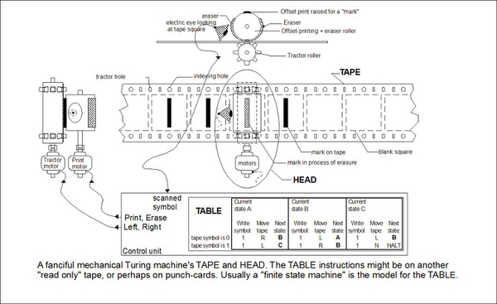
Welcome to Turing’s World

